Slide 1
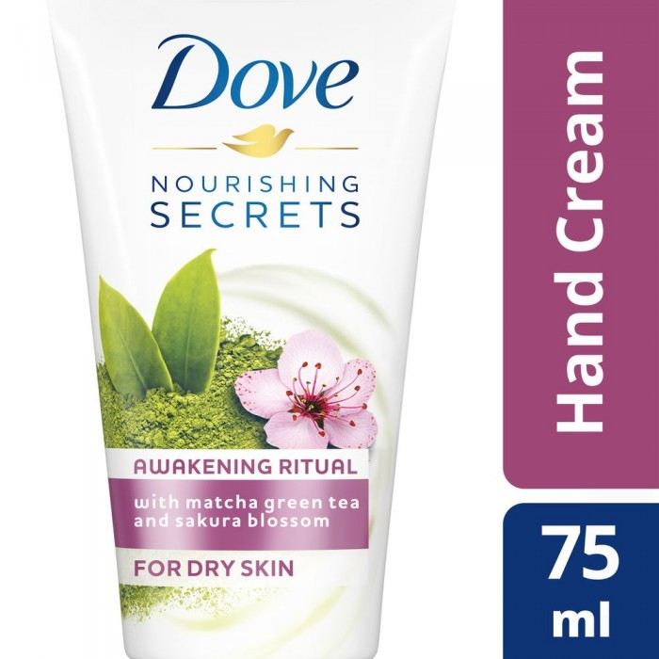
Dove
Dove Hand Cream Vital Routine 75 ml
QR 20.70 Q
Use Dove's Hand Cream Vital Skin Rejuvenation Routine. This very rich formula hydrates your hands deeply and gives them a smooth texture while soothing your senses. The result? Get rid of dry hands. Skin looks rejuvenated and smooth.

Slide 2
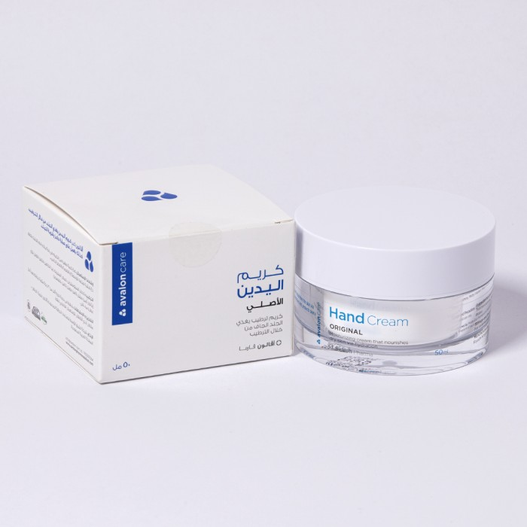
Avalon
Avalon Care Hand Cream 50ml
41.40 SAR. Q
Avalon Care Hand Cream with its unique formula keeps the daily hydration that skin needs. It is a moisturizer that nourishes the skin and works to regenerate and protect the moisture barrier in the skin. It provides long-lasting moisturizing of the hands and its effect.
Uses:
- Anaphylaxis
- Eczema
- Dry skin

Slide 3
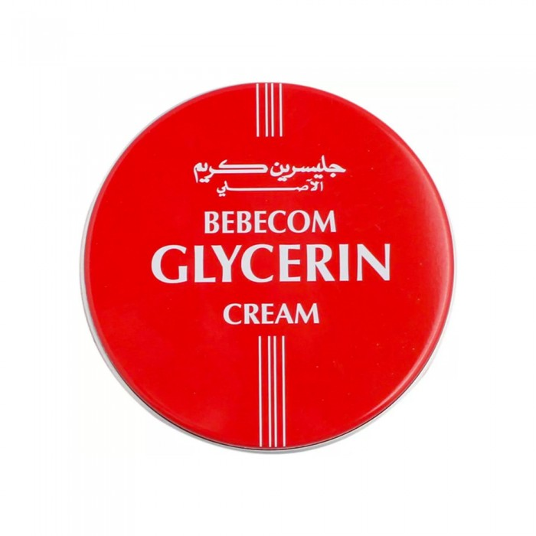
Bebekom
Pebicom Glycerin Original Moisturizer Cream For Skin 400ml
23.00 SAR. Q
Bebecom Glycerin cream is a high performance skin care cream, carefully designed for sensitive and dry skin. Rich in renewable active ingredients and balanced moisturizing properties of glycerin that protect skin from harsh elements. It immediately works on rough, dry, cracked skin and creates a protective barrier.

Slide 4
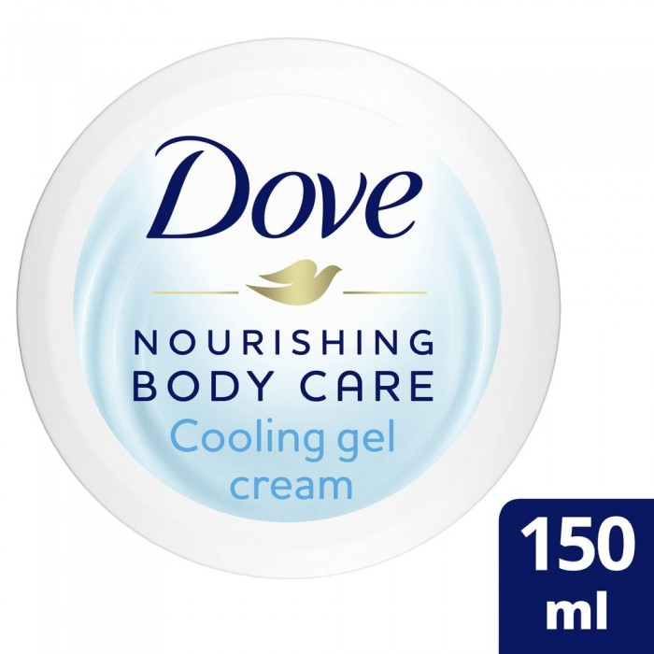
Dove
Dove Cream Refreshing Gel 150 ml
16.10 SAR. Q
Dove refreshing gel cream for smooth, velvet, bright and sparkling skin; with cell moisturizers; Fast absorption; Suitable for sensitive skin. It was tested by dermatologists.

Slide 5
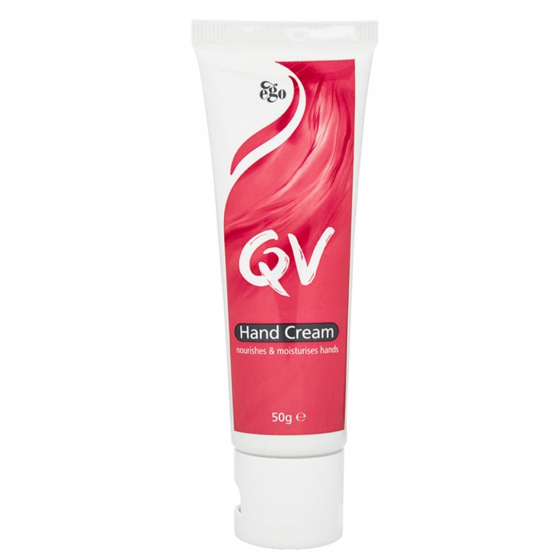
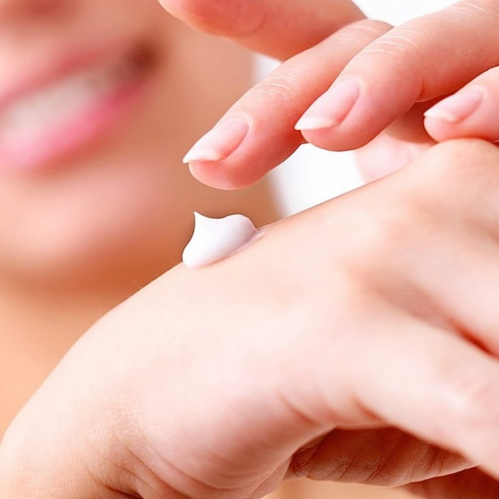
Ego Qiu in
Cream Kew In Your Hand Hydration
SAR 55.20 Q
QIU cream in your hand hydration is an effective moisturizer for dry, ordinary and sensitive skin. Keo cream in special hand hydration is also free of lanolin and does not irritate the skin. QI cream in special hand hydration is rich in a non-greasy formula that protects, hydrates and nourishes hands to leave skin smooth. Place Q cream in the hands gently several times throughout the day, including fingertips and down to the wrists, and on the nails and surrounding area with special attention to the back of the hands for skin care and nails and to make them look good. Cream Q In constantly moisturizes hands throughout the day, especially after washing or sanitizing them.

